Slide 1
UASCs – Learning from the Kent experience
Dr Georgie Siggers, Interim Designated Doctor for LAC Kent
Nancy Sayer, Designated Nurse for LAC Kent

Slide 2
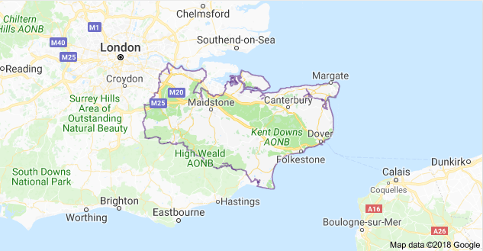
Kent
Notes:
Nancy to introduce the aims of the talk and what will be covered. – very quick

Slide 3
The “Crisis”
213 UASCs in Oct 15
End of Dec 2015, 600 who had not received IHA
Historic arrangement with GP practice for 4 per week
1200 UASCs by mid 2016
Range of health and safeguarding concerns
Notes:
Nancy

Slide 4
Who are the Kent UASCs?
The majority are males aged 15–18
Country of Origin
Eritrea
Syria
Afghanistan
Sudan
Kuwait
Iran

Slide 5
Where did they go?
Female: Foster care
Male under 16 years: Foster care
Male 16–18 years: Reception centres or independent living

Slide 6
What we did?
Set up UASC health team
CAMHS project
IHA capacity
Pathways & processes
Raising awareness
Needs assessment

Slide 7
The UASC Health Team
Commissioning
Designated LAC professionals
Public health
CAMHS

Slide 8
What we did?
Set up UASC health team
CAMHS project
IHA capacity
Pathways & processes
Raising awareness
Needs assessment

Slide 9
The Needs Assessment
Psychological signs/symptoms (41%)
Physical complaints common
Dental (43%)
Vision (35%)
High risks for TB & Hep B

Slide 10
What we did?
Set up UASC health team
CAMHS project
IHA capacity
Pathways & processes
Raising awareness
Needs assessment

Slide 11
The CAMHS project
Competency Framework
Sleep
https://youtu.be/7pcV7FJp0hU
Hope
Nutrition

Slide 12
What we did?
Set up UASC health team
CAMHS project
IHA capacity
Pathways & processes
Raising awareness
Needs assessment

Slide 13
Increasing IHA capacity
National call for help
Commisioned London support
Trained local GPs
Developed resources, forms, templates etc.
www.uaschealth.org

Slide 14
What we did?
Set up UASC health team
CAMHS project
IHA capacity
Pathways & processes
Raising awareness
Needs assessment

Slide 15
TB
Blood borne infections
Dental
Vision
Immunisations
Sexual health
Pathway and processes

Slide 16
What we did?
Set up UASC health team
CAMHS project
IHA capacity
Pathways & processes
Raising awareness
Needs assessment

Slide 17
Raising awareness
Consent
Confidentiality
UASC accessible information

Slide 18
uaschealth.org.uk

Slide 19
Early 2015
-200 UASCs
2015/16
Massive influx
Now
National Transfer Scheme
1200
Notes:
Neglect can have consequences for children that last lifetimes, if not generations
Need to raise awareness of the health implications
Need to lower threshold to report
Need to recognise & support long term effects
Define neglect
Think about why parents neglect
How can we recognise neglect
General health effects
Some science
Focus on emotional health
Briefly, what do we need to do

Slide 20
The National Transfer Scheme
In place since 1st July 2016
Moves new UASCs to other Local Authority Areas
Extra challenge to health
NHS number
GP registration
Heath status
Notes:
Huge challenges – due to sudden increase in numbers and because a system was not in place to meet demand, new provider etc.

Slide 21
The fitness to travel FTT model
Fitness to travel screen
Nurse led
GP support
Rated red, amber, green
Stay
Liaise
Go

Slide 22
RHAs
Large numbers requiring RHAs
Health histories
Missed screening

Slide 23
Summary
Set up UASC health team
CAMHS project
IHA capacity
Pathways & processes
Raising awareness
Needs assessment
www.uaschealth.org

Slide 24
Thank you for listening
UASCs are children first,
asylum seekers second

